Slide 1

Startup Success Prediction
Isbah Arif - 23L-3014 - task assignment
Zain Allaudin - 23L-3036 - task assignment
Mishaal Rafique - 23L-3044 - task assignment
Eshal Shahid - 23L-3086 - task assignment
National University of Computer and Emerging Sciences, Lahore

Slide 2
Problem
Startup success (operating/acquired/closed) is hard to predict due to factors like funding, market, and geography.
Dataset has missing, imbalanced, and skewed data, making modeling difficult.
Without preprocessing, models give low performance (weak predictions).

Slide 3
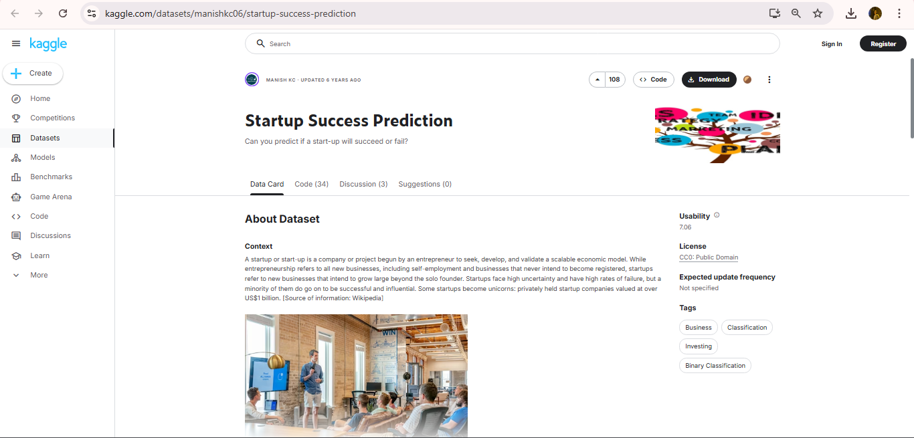
Dataset Title with website link
https://www.kaggle.com/datasets/manishkc06/startup-success-prediction

Slide 4
Dataset Title with website link
Dataset Description
No of records: ______923_________
No of Attributes: _____ 49_______
Among all mention important Attributes: _____funding_total_usd, funding rounds (A–H), country_code, market, founded_at, first_funding_at, last_funding_at, status (target)______

Slide 5
Reason of selection
Startup success prediction is important for real-world decisions by investors and entrepreneurs.
The dataset includes key features like funding, market, country, and dates.
Contains real data issues (imbalance, missing, skewed) suitable for preprocessing analysis.

Slide 6
Exahustive List of Preprocessing techniques
Technique Studies and Applied | Technique Not Studies and Applied
Missing Values Handling | Log Transformation
Duplicate Removal | Power Transformation (Yeo-Johnson)
Inconsistent Data Correction | Frequency Encoding
Outlier Removal (IQR, Z-score) | Target Encoding
Feature Scaling (Min-Max, Z-score) | Date Feature Extraction
One-Hot Encoding | Feature Engineering
Correlation-Based Selection | SMOTE Oversampling
Chi-Square Selection | Random Undersampling
PCA | TF-IDF Encoding

Slide 7
Exahustive List of Preprocessing techniques
Technique Studies and Applied | Technique Not Studies and Applied
Sampling (Random, Stratified) | Label Encoding
Discretisation (Binning) | RFE Feature Selection
Apriori Algorithm
FP-Growth Algorithm
Noise Smoothing

Slide 8
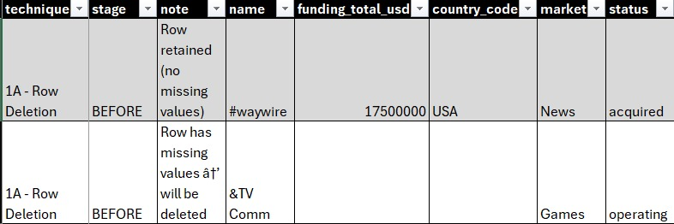
Row Deletion
Definition: Remove all rows that contain missing values.
Effect :
before
after

Slide 9
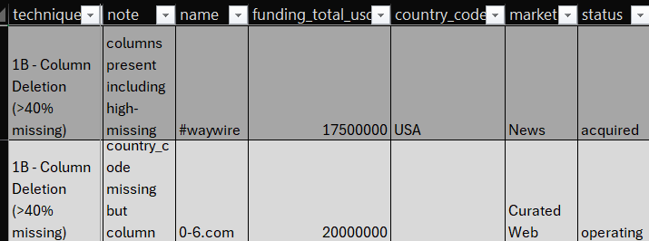
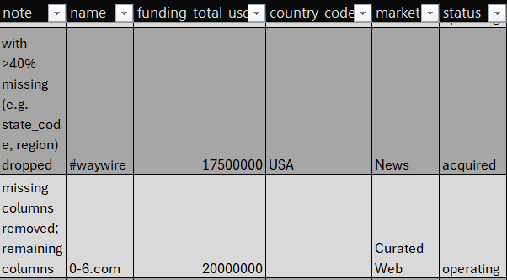
Column Deletion
Definition: Remove all columns that contain missing values.
Effect :
before
after

Slide 10
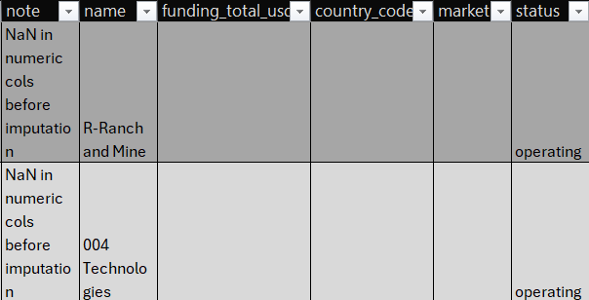
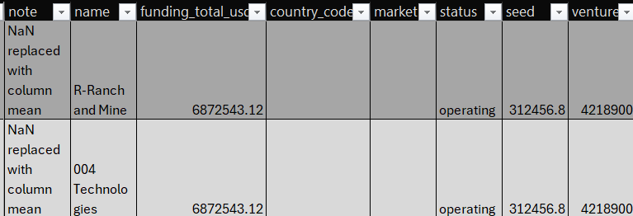
Mean Imputation
Definition: Replace missing numeric values with the mean of the column.
Effect :
before
after

Slide 11
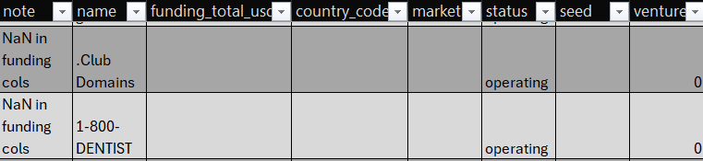
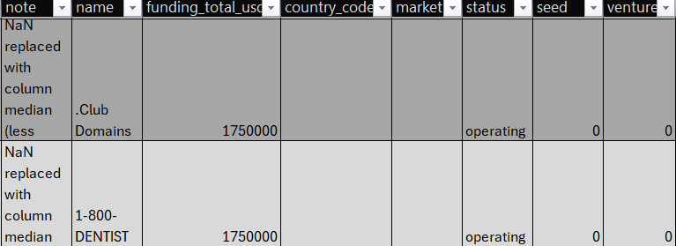
Median Imputation
Definition: Replace missing numeric values with the median of the column.
Effect :
before
after

Slide 12
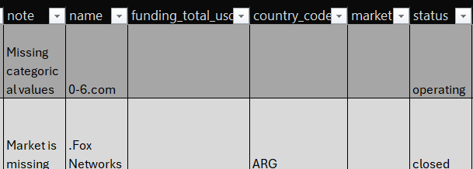
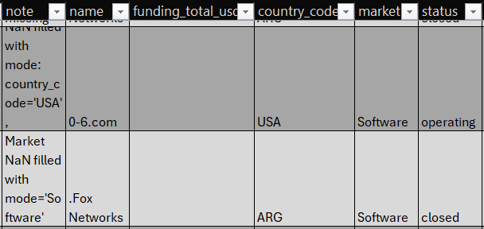
Mode Imputation
Definition: Replace missing categorical values with the most frequent value.
Effect :
before
after

Slide 13
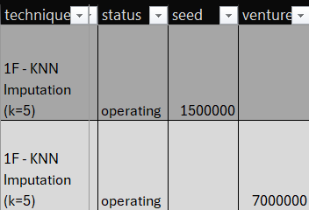
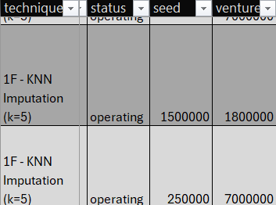
KNN Imputation
Definition: Impute missing values based on the values of k nearest neighbors.
Effect :
before
after

Slide 14
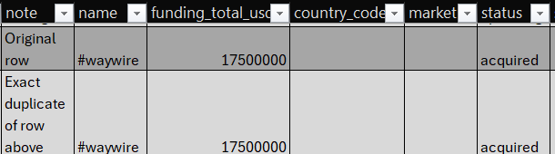
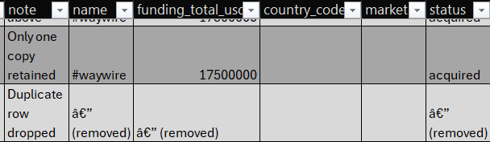
Duplicate Removal
Definition: Remove rows that are exact duplicates.
Effect :
before
after

Slide 15
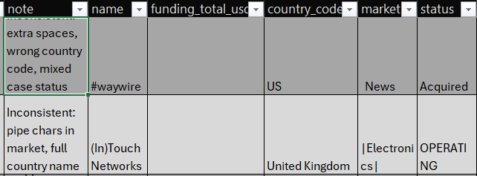
Inconsistent Data Correction
Definition: Standardize inconsistent values (e.g., US to USA, lowercase text, strip spaces).
Effect :
before v
after

Slide 16
Outlier Removal (IQR)
Definition: Remove rows outside 1.5×IQR above Q3 or below Q1.
Effect :
before
after

Slide 17
Outlier Removal (Z-score)
Definition: Remove rows where z-score exceeds 3 (standard deviations from mean).
Effect :
before
after

Slide 18
Min-Max Normalisation
Definition: Scale numeric features to [0,1] range.
Effect :
before
after

Slide 19
Z-score Standardisation
Definition: Scale numeric features to mean=0, std=1.
Effect :
before
after

Slide 20
Log Transformation
Definition: Apply log(x+1) to reduce skew in numeric features.
Effect :
before
after

Slide 21
Power Transformation (Yeo-Johnson)
Definition: Transform numeric features to approximate normality, and handle zeros and negatives.
Effect :
before
after

Slide 22
Label Encoding
Definition: Convert categorical values into integer codes.
Effect :
before
after

Slide 23
One-Hot Encoding
Definition: Convert categorical variables into binary indicator columns.
Effect :
before
after

Slide 24
Target Encoding
Definition: Encode categorical variables using the mean of the target variable for each category.
Effect :
before
after

Slide 25
Feature Engineering
Definition: Create new features from existing ones (e.g., total funding rounds, funding per round, has_equity).
Effect :
before
after

Slide 26
Correlation-Based Feature Selection
Definition: Remove features that are highly correlated with others (|r| > 0.90).
Effect :
before
after

Slide 27
Chi-Square Feature Selection (top 10)
Definition: Select top-k features most statistically associated with the target using the Chi-square test.
Effect :
before
after

Slide 28
RFE Feature Selection (top 8)
Definition: Iteratively remove least important features until a desired number of features remain.
Effect :
before
after

Slide 29
PCA (n=5, var=0.37)
Definition: Transform original features into uncorrelated principal components
Effect :
before
after

Slide 30
PCA (n=10, var=0.57)
Definition: Iteratively remove least important features until a desired number of features remain.
Effect :
before
after

Slide 31
PCA (n=15, var=0.76)
Definition: Transform original features into uncorrelated principal components.
Effect :
before
after

Slide 32
PCA (n=15, var=0.76)
Definition: Transform original features into uncorrelated principal components.
Effect :
before
after

Slide 33
PCA (n=15, var=0.76)
Definition: Transform original features into uncorrelated principal components.
Effect :
before
after

Slide 34
PCA (n=15, var=0.76)
Definition: Transform original features into uncorrelated principal components.
Effect :
before
after

Slide 35
Random Sampling (frac=0.25)
Definition: Randomly select a fraction of rows from the dataset to create a smaller subset.
Effect :
before
after

Slide 36
Random Sampling (frac=0.5)
Definition: Randomly select a fraction of rows from the dataset to create a smaller subset.
Effect :
before
after

Slide 37
Random Sampling (frac=0.75)
Definition: Randomly select a fraction of rows from the dataset to create a smaller subset.
Effect :
before
after

Slide 38
Stratified Sampling (50%)
Definition: Randomly select a fraction of rows while preserving the distribution of target variable.
Effect :
before
after

Slide 39
SMOTE Oversampling
Definition: Generate synthetic samples for minority classes to balance class distributions.
Effect :
before
after

Slide 40
Random Undersampling
Definition: Generate synthetic samples for minority classes to balance class distributions.
Effect :
before
after

Slide 41
Discretisation (Binning)
Definition: Generate synthetic samples for minority classes to balance class distributions.
Effect :
before
after

Slide 42
Results: Effects of Different techniques
Technique(s) | Accuracy | Precision | F1 | Specificity | Simplicity | AUC
Row Deletion | 0.4453 | 0.8315 | 0.5309 | 0.8262 | 0.1590 | 0.7058
Column Deletion | 0.4323 | 0.8387 | 0.5241 | 0.8252 | 0.1588 | 0.6992
Mean Imputation | 0.4323 | 0.8387 | 0.5241 | 0.8252 | 0.1588 | 0.6992
Median Imputation | 0.4323 | 0.8387 | 0.5241 | 0.8252 | 0.1588 | 0.6992
Mode Imputation | 0.4240 | 0.8383 | 0.5153 | 0.8273 | 0.1585 | 0.7050
KNN Imputation | 0.4323 | 0.8387 | 0.5241 | 0.8252 | 0.1588 | 0.6992
Duplicate Removal | 0.4323 | 0.8387 | 0.5241 | 0.8252 | 0.1588 | 0.6992
Inconsistent Data Correction | 0.4302 | 0.8422 | 0.5217 | 0.8365 | 0.1602 | 0.7008

Slide 43
Results: Effects of Different techniques
Technique(s) | Accuracy | Precision | F1 | Specificity | Simplicity | AUC
Outlier Removal (IQR) | 0.4174 | 0.8529 | 0.5122 | 0.8459 | 0.1594 | 0.6935
Outlier Removal (Z-Score) | 0.4235 | 0.8362 | 0.5125 | 0.8219 | 0.1592 | 0.6882
Min-Max Normalisation | 0.4113 | 0.8390 | 0.5034 | 0.8337 | 0.1586 | 0.6952
Z-Score Standardisation | 0.4322 | 0.8385 | 0.5240 | 0.8245 | 0.1588 | 0.6989
Log Transformation | 0.4324 | 0.8387 | 0.5242 | 0.8252 | 0.1588 | 0.6992
Power Transformation (Yeo-Johnson) | 0.4324 | 0.8388 | 0.5242 | 0.8252 | 0.1590 | 0.6993
Label Encoding | 0.4318 | 0.8383 | 0.5219 | 0.8242 | 0.1584 | 0.6985

Slide 44
Results: Effects of Different techniques
Technique(s) | Accuracy | Precision | F1 | Specificity | Simplicity | AUC
One-Hot Encoding | 0.5145 | 0.8333 | 0.6015 | 0.7681 | 0.1598 | 0.7054
Frequency Encoding | 0.4417 | 0.8429 | 0.5330 | 0.8349 | 0.1597 | 0.7003
Target Encoding | 0.4873 | 0.8421 | 0.5776 | 0.8149 | 0.1624 | 0.7142
Data Feature Extraction | 0.6049 | 0.8639 | 0.6811 | 0.8533 | 0.1580 | 0.8019
Feature Engineering | 0.4340 | 0.8333 | 0.5277 | 0.8068 | 0.1599 | 0.6953
Correlation Based Feature Selection | 0.4327 | 0.8387 | 0.5247 | 0.8246 | 0.1592 | 0.6990
Chi-Square Feature Selection | 0.3982 | 0.8472 | 0.4873 | 0.8606 | 0.1589 | 0.7015

Slide 45
Results: Effects of Different techniques
Technique(s) | Accuracy | Precision | F1 | Specificity | Simplicity | AUC
RFE Feature Selection | 0.4589 | 0.8384 | 0.5507 | 0.8133 | 0.1586 | 0.7013
PCA (n=5, var=0.37) | 0.3517 | 0.8301 | 0.4349 | 0.8354 | 0.1562 | 0.6445
PCA (n=10, var=0.57) | 0.3742 | 0.8349 | 0.4603 | 0.8378 | 0.1573 | 0.6583
PCA (n=15, var=0.76) | 0.3886 | 0.8281 | 0.4783 | 0.8139 | 0.1561 | 0.6493
Random Sampling (frac=0.25) | 0.4404 | 0.8363 | 0.5331 | 0.8112 | 0.1649 | 0.6721
Random Sampling (frac=0.5) | 0.4120 | 0.8373 | 0.5041 | 0.8294 | 0.1592 | 0.6682

Slide 46
Results: Effects of Different techniques
Technique(s) | Accuracy | Precision | F1 | Specificity | Simplicity | AUC
Random Sampling (frac=0.75) | 0.4152 | 0.8412 | 0.5076 | 0.8362 | 0.1578 | 0.6972
Stratified sampling (50%) | 0.4087 | 0.8391 | 0.4979 | 0.8357 | 0.1593 | 0.6823
SMOTE oversampling | 0.7238 | 0.8041 | 0.7572 | 0.4832 | 0.1553 | 0.6865
Random undersampling | 0.4659 | 0.8268 | 0.5572 | 0.7728 | 0.1655 | 0.6630
Discretisation (Binning) | 0.4189 | 0.8412 | 0.5106 | 0.8378 | 0.1583 | 0.6944
Noise smoothing (Bin-Mean) | 0.4478 | 0.8339 | 0.5386 | 0.8041 | 0.1585 | 0.7013

Slide 47
Results: Effects of Different techniques
Most techniques produced marginal or no improvement over the baseline (Accuracy = 0.4323, AUC = 0.6992)
Feature-level techniques (encoding, extraction) and resampling methods showed the most notable gains
Data cleaning, scaling, and PCA consistently underperformed, not critical issues in this dataset
Feature-level interventions and data distribution techniques proved most impactful for improving model performance

Slide 48
Final Results
Results were obtained by applying each technique independently against the baseline (Accuracy = 0.4323, AUC = 0.6992)
SMOTE achieved best overall performance: Accuracy: 0.7238, F1: 0.7572, followed by Data Feature Extraction (Accuracy: 0.6049, AUC: 0.8019)
SMOTE succeeded by directly addressing class imbalance through synthetic minority sample generation
Data Feature Extraction succeeded by creating more discriminative features, providing stronger learning signals

Slide 49
Final Results
Most techniques failed to improve as data cleaning, scaling, and dimensionality reduction (PCA) either discarded useful information or addressed issues not critical to this dataset
Notable trade-off: SMOTE improved Accuracy & F1 but reduced Specificity (0.4832) due to increased sensitivity toward minority class
SMOTE selected as the best technique for its superior classification performance and effective handling of class imbalance

Slide 50
THANK YOU & questions please

